Slide 1

Francois Brouet – sep24_continuous_ds

Slide 2
Subject, problem, issues
Data (volume, architecture)
Data visualization
Pre-processing
Long .frequencies: Trained models and results, best model
Long. displacements: Trained models and results, best model
Link results with the business issue
Criticism and outlook
20 min presentation
10 questions
2

Slide 3
Introduction
01

Slide 4
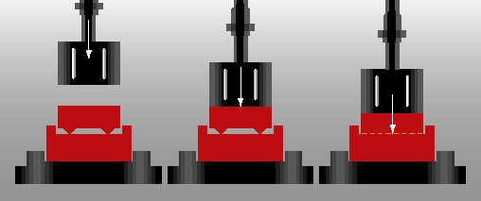
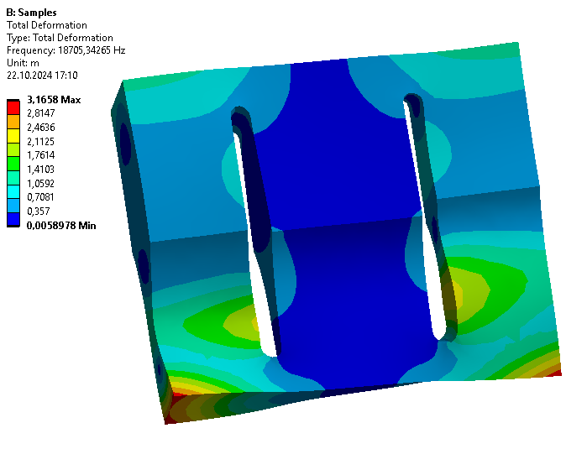
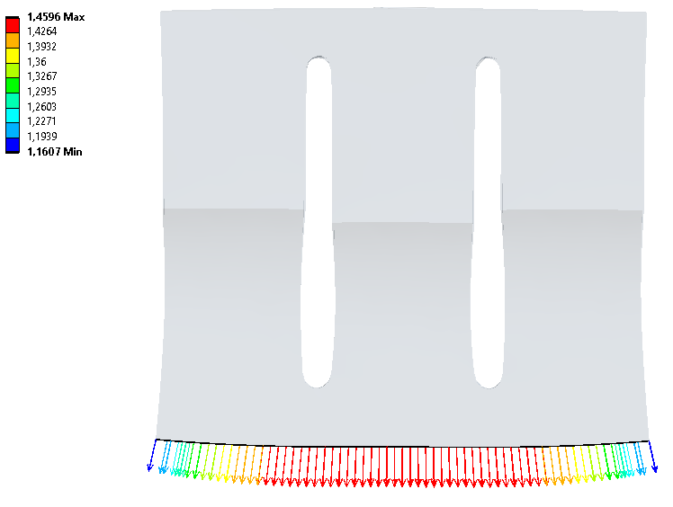
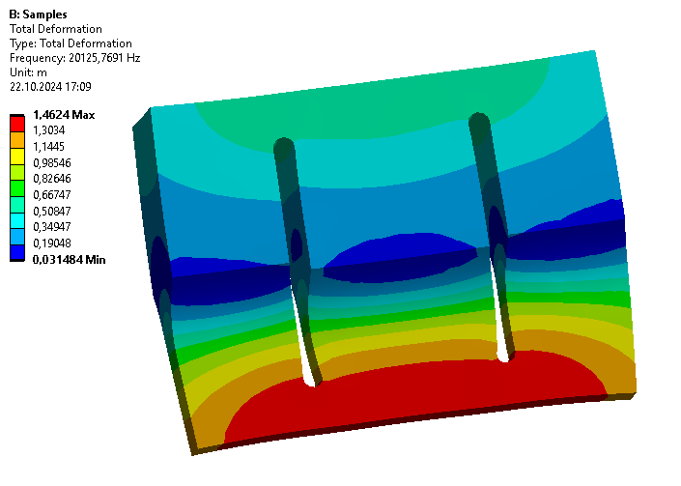
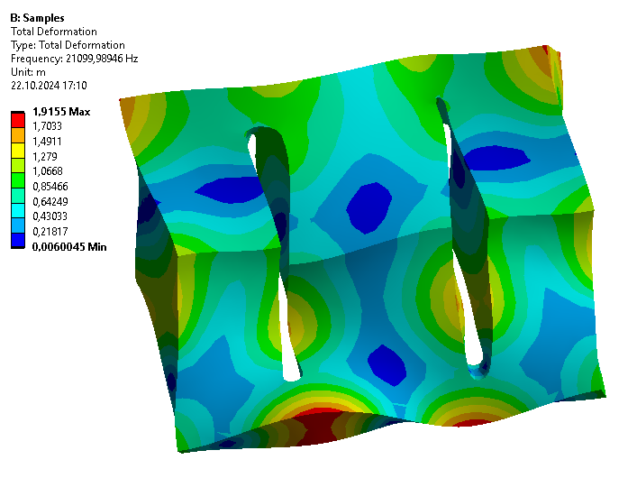
Context
Concept of the ultrasonic welding:
convert the vibration energy to the welding parts
energy transformed in heat by friction
with mechanical force → new connection
Ultrasonic sonotrode
longitudinal mode used to drive the vibration
must meet requirements:
frequency ~ 20 kHz
longitudinal mode isolated
uniform displacements at the output
Notes:
US-Welding
Mechanical vibrations transfer the kinetic energy into a part
This energy is transformed in heat by the surface friction
The material starts to melt
The material is compressed by a mechaniical force (parallel to melting)
A new homogeneous connection is created
Sonotrode:
is in contact with the welding part
has many vibrating modes (each mode has a eigenfrequency and a eigenshape)
longitudinal mode is used
Simulation with FEM software (ANSYS)
Requirements
Longitudinal mode‘s frequency should be close to 20 kHz (driving frequency)
Longitudinal mode should be isolated from other modes
Longitudinal mode‘s displacements should be as uniform as possible over the welding surface

Slide 5
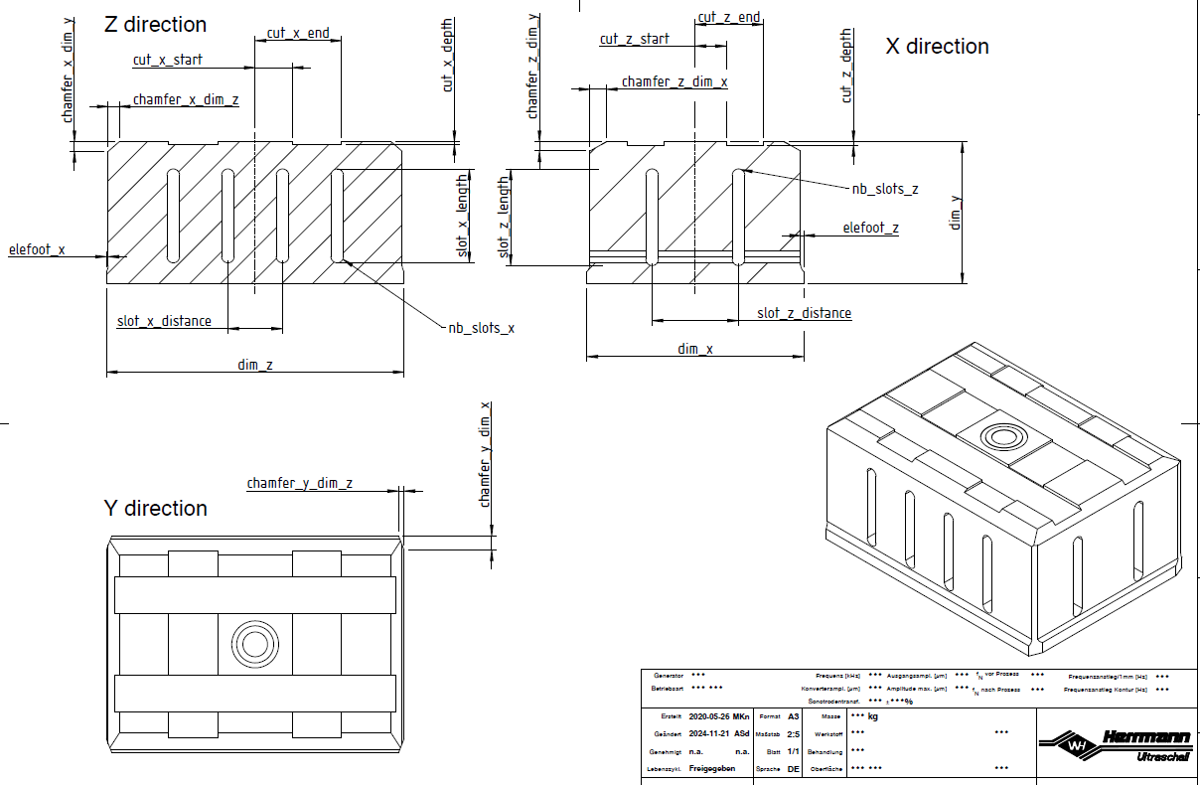
Goal
Main goal: Prediction of the FEM results from the sonotrode geometry
3 predictions:
longitudinal frequency
frequencies of all modes
uniformity of the output displacements
Geometry: 23 parameters
(dim_x) × (dim_z): output surface
(dim_y): length
…
Notes:
Goal of this project was to predict the results of FEM simulations (modal properties) without running them
Simulations of complex geometries are computer-intensive → one iteration can take up to an hour
FEM results splitted in 3 subgoals (different target variables)
- Prediction of the longitudinal mode’s frequency (or “long. frequency”)
- Prediction of the frequency of all other modes: Focus near the longitudinal mode (ex: 5 modes below and 5 modes above).
- Prediction of the uniformity of the displacements (as a number), instead of all displacement values
Each subgoal:
visualization
parameter influences
modeling
result interpretation
Geometry
dim_x / dim_z welding (output) surface, usually fixed by the welding part
dim_y: oscillation length, important feature to tune the longitudinal frequency
here: 4 slots and 2 slots in both directions
other dimensions: free, used to optimize the modal properties

Slide 6
Preprocessing
Identification of the longitudinal mode
Criterion NRDD
(Data visualization Streamlit)
NRDD: examples good/bad + distribution

Slide 10
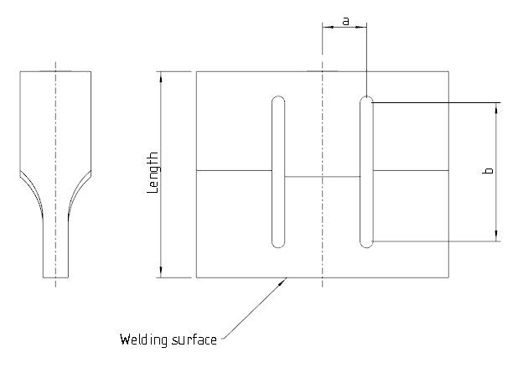
Tuning of the sonotrode geometry
The output surface is mostly defined by the welding part and can not be changed
The rest can be used to optimize the modal properties (tuning)
Typically the length tunes the frequency
Other parameters
a (slot position)
b (slot length)
…

Slide 11
Project
03

Slide 12
Goal of the project: Create a model to predict FEM results
Model can be trained with FEM calculations
Design point can be chosen by the model
One design point ~ 1 minute
Predict FEM results with calculation
Combine prediction with optimization (optional goal)

Slide 13
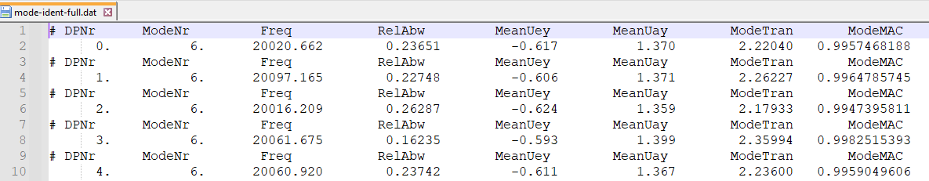
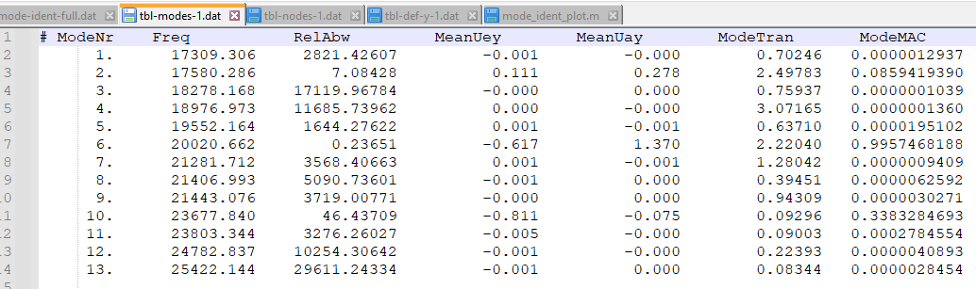
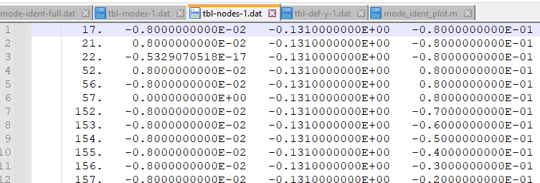
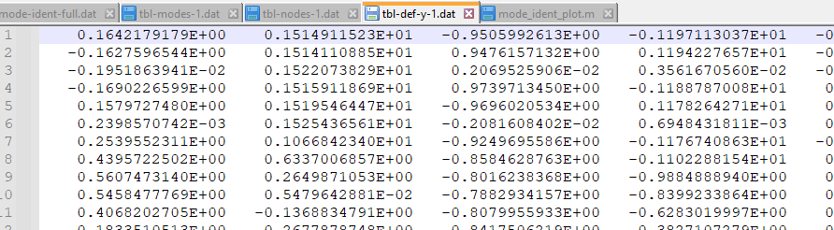
Post-processing script in ANSYS:
Identifies the longitudinal mode and its frequency (Global file for all design points)
Exports result data (One file for each design point):
List of modes and frequencies
List of node coordinates of the welding surface
List of node displacements of the welding surface

Slide 14
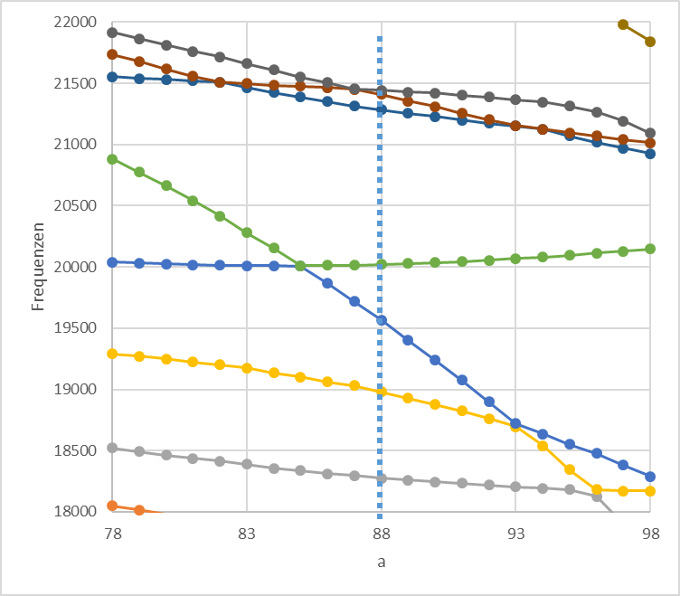
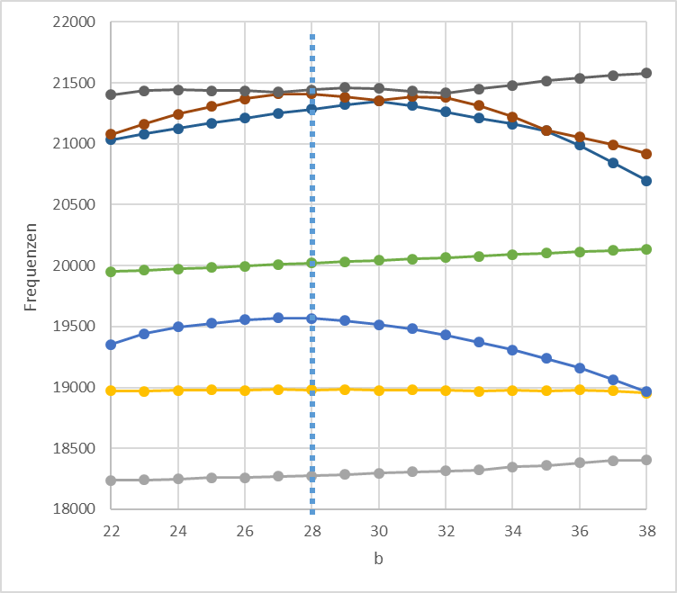
Example: Impact of the slots on modal frequencies
a: slot position
b: slot length

Slide 16

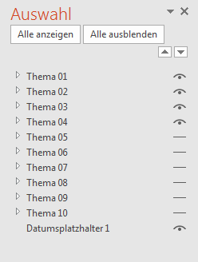
Ein- / Ausblenden von Agenda Themen
Entfernen bzw. hinzufügen weiterer Themen:
Start > Abschnitt „Bearbeiten“ > Markieren > Auswahlbereich
Dann erscheint rechts das Fenster Auswahl. Hier lassen sich einzelne Objekte aus- bzw. einblenden (klicken auf das „Augen-Symbol).
Agenda
01
Thema 01
02
Thema 02
03
Thema 03
04
Thema 04
05
Thema 05
06
Thema 06
07
Thema 07
08
Thema 08
09
Thema 09
10
Thema 10

